Slide 1
Chapter 1
Software Characteristics

Slide 2
Objectives
Describe software problems
Describe the characteristics of the software as a process
Describe the characteristics of the software as a product
Explain the need for the Software Engineering discipline
Define Software Engineering goals
Discuss the role of a Software Engineer in its current context

Slide 3
Software Engineering- Definition
“The application of a systematic, disciplined, quantifiable approach to the development, operation and maintenance of software; that is, the application of engineering to software.” - IEEE Glossary

Slide 4
Software Defined
A collection of computer programs, procedures, rules, and associated documentation and data.

Slide 5
Software – The Problems
Cost of Software
Reliability
Change and Rework

Slide 6
Software as a process
Consists of a set of activities
Includes constraints
Desired output is high quality product at low cost

Slide 7
Software Process Characteristics
Predictability
Support Testability and Maintainability
Early Defect Removal and Prevention
Process Improvement

Slide 8
Software as a product
Developed or engineered
Malleable
Does not “wear out”
Most are custom-built, rather than being assembled from existing components

Slide 9
Why Software Engineering?
Plays an Influencing role in the development of Software and its Quality

Slide 10
The influencing role of Software Engineering
Individual ability
Team communication
Non-linear estimation
Change control
Available project time
Problem understanding
Inadequate training
Lack of management skills
(Rising) Level of user expectations

Slide 11
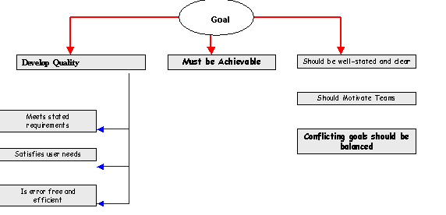
Software Engineering Goals
Project development is a phased activity
Each phase has its specific set of goals

Slide 12
A Software Engineer defined
“A Software Engineer is a person who applies Software Engineering principles to the process of software development.”

Slide 13
Role of a Software Engineer
Be a good programmer
Be familiar with various design approaches
Be able to translate user requirements into specifications
Be able to interact with the users on various areas of an application
Possesses good managerial skill

Slide 14
Summary
Software cost forms the major component of a computer system’s cost. Software is currently extremely expensive to develop and is often unreliable.
Software is not just a set of computer programs but comprises of programs and associated data and documentation. Each of these items is a part of the software engineering process. The main problems for software development currently are: high cost, low quality, and frequent changes causing change and rework.
Software has become a limiting factor in the evolution of computer-based systems. The intent of software engineering is to produce a framework for building higher quality software.

